Slide 1
Magnetism and Electromagnetism
The Magnetic Field
A permanent magnet has a magnetic field surrounding it. A magnetic field is envisioned to consist of flux lines that radiate from the north pole to the south pole and back to the north pole through the magnetic material.

Slide 2
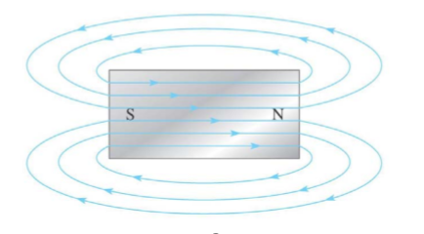

Slide 3
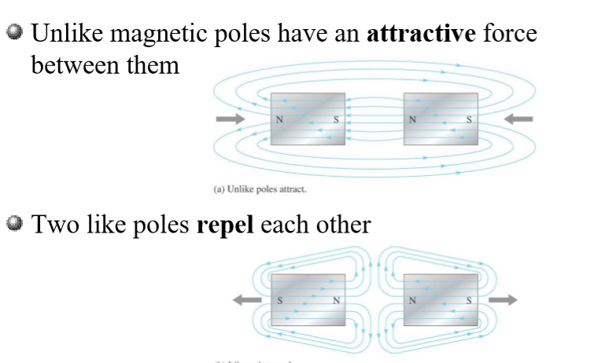
Attraction and Repulsion

Slide 4
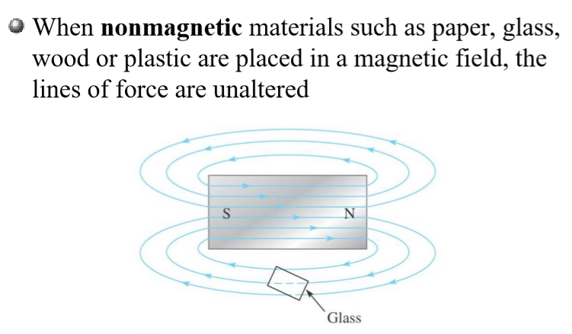
Altering a Magnetic Field

Slide 5
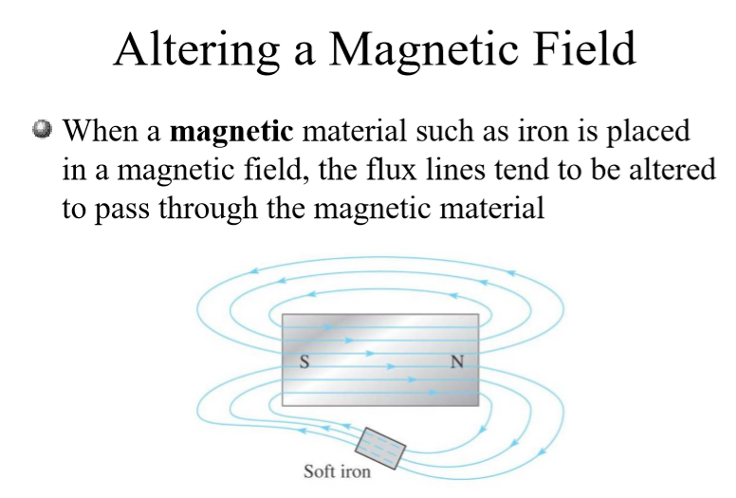

Slide 6
Magneto Motive Force (MMF)
The magnetic pressure which sets up or tends to set up magnetic flux in a magnetic circuit is known as MMF.
Magneto motive force is the measure of the ability of a coil to produce flux.
2. The magnetic flux is due to the existence of the MMF
caused by a current flowing through a coil having no. of
turns.
3. A coil with ‘N’ turns carrying a current of ‘I’ amperes
represents a magnetic circuit producing an MMF of NI
MMF=NI
4. Units of MMF = Ampere turns(AT)

Slide 7

Magnetic Flux:
The amount of magnetic lines of force set-up in a magnetic circuit is called magnetic flux.
2. The magnetic flux, that is established in a magnetic circuit is proportional to the MMF and the proportional constant is the reluctance of the magnetic circuit.

Slide 8
3. The unit of magnetic flux is Weber.
Reluctance:
1. The opposition offered to the flow of magnetic flux in a magnetic circuit is called reluctance .
2. Reluctance of a magnetic circuit is defined as the ratio of magneto motive force to the flux established.
3. Reluctance depends upon length(l), area of cross-section(a) and permeability of the material that makes up the magnetic circuit.(S l, S a, S l/a )

Slide 9

unit of reluctance is AT/ Wb
4. The Magnetic field strength(H)
1. If the magnetic circuit is homogeneous, and of uniform cross-sectional area, the magnetic field strength is defined as the magneto motive force per unit length of magnetic circuit.

Slide 10

2. The unit of magnetic field strength is AT/m
Magnetic flux density(B)
1. The magnetic flux density in any material is defined as the magnetic flux established per unit area of cross-section.

Slide 11


Slide 12
Relative permeability
1. It is defined as the ratio of flux density established in magnetic material to the flux density established in air or vacuum for the same magnetic field strength.

Slide 13
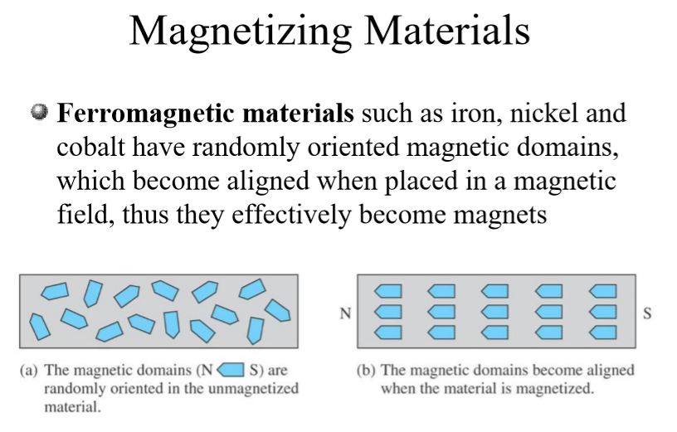

Slide 14
INTRODUCTION TO ELECTROMAGNETIC INDUCTION
When a conductor moves in a magnetic field, an EMF is generated; when it carries current in a magnetic field, a force is produced. Both of these effects may be deduced from one of the most fundamental principles of electromagnetism, and they provide the basis for a number of devices in which conductors move freely in a magnetic field. It has already been mentioned that most electrical machines employ a different form of construction.

Slide 15
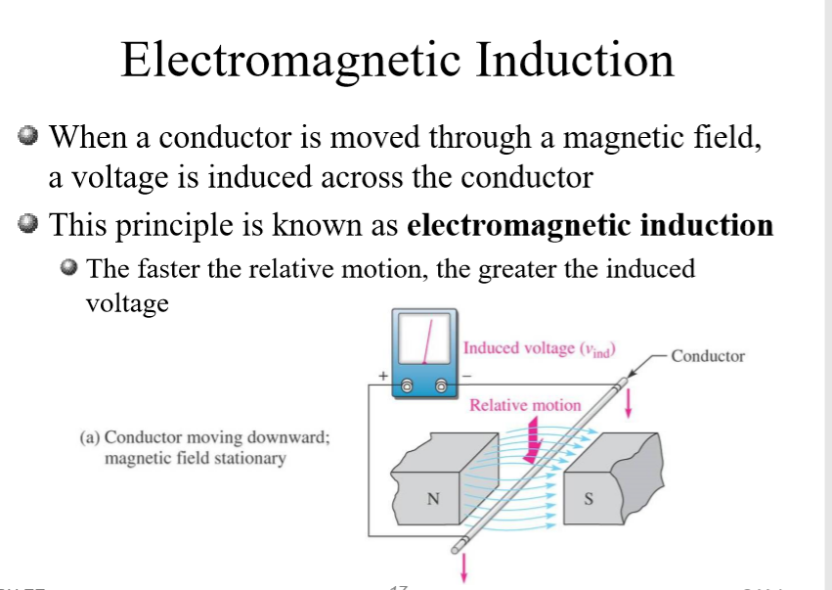

Slide 16
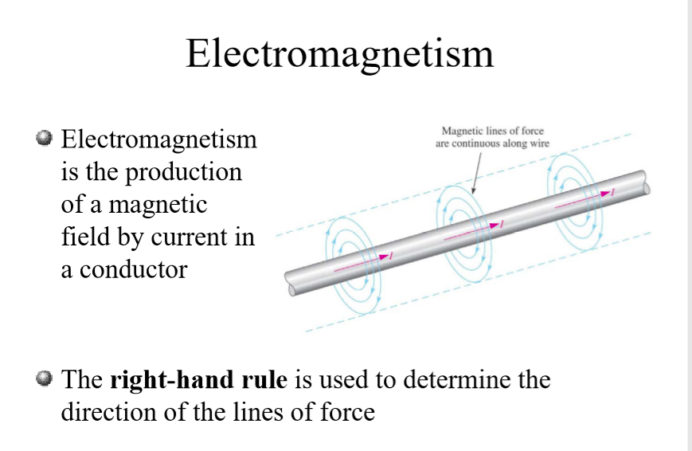

Slide 17
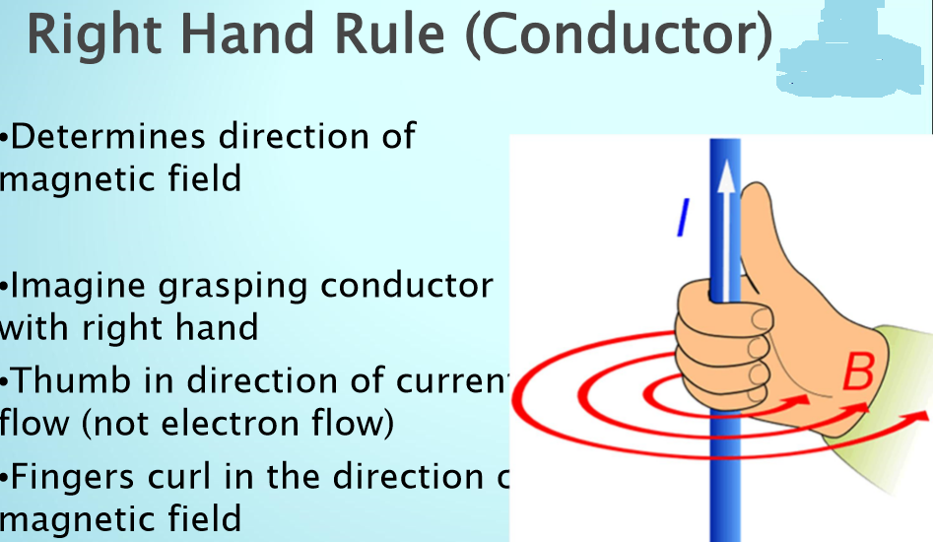

Slide 18
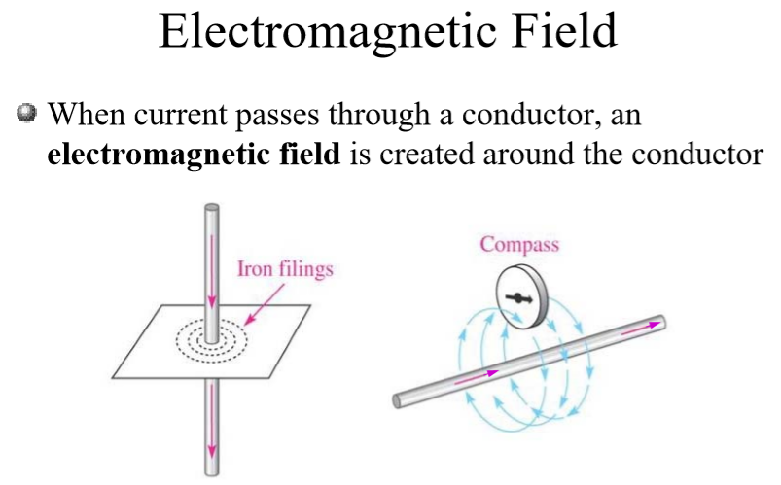

Slide 19
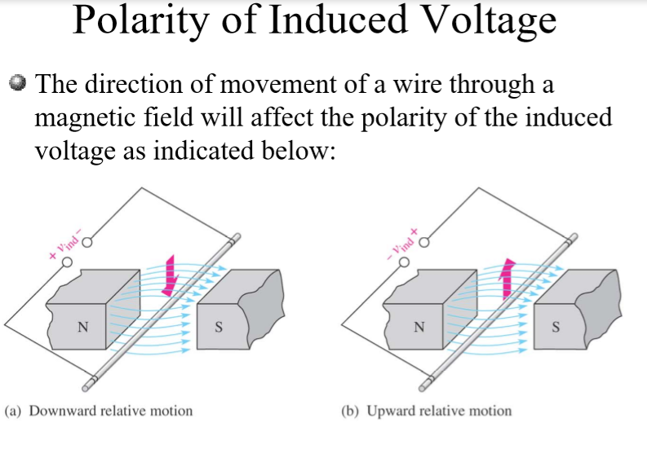

Slide 20
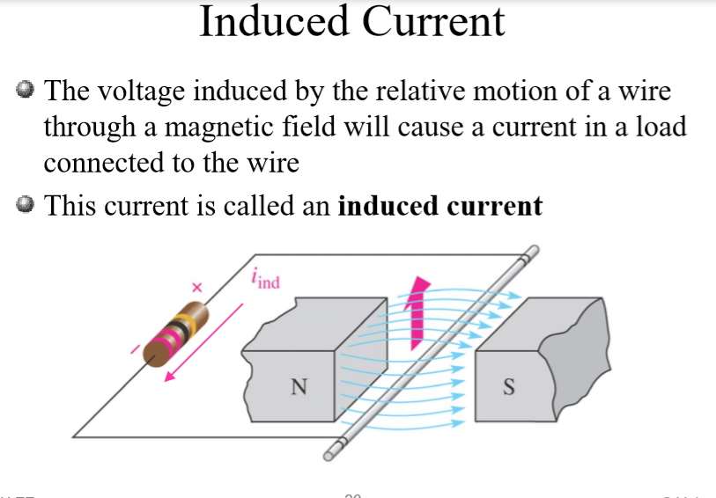

Slide 21

Faraday’s Law
Faraday’s Law states that, the voltage induced across a coil of wire equals the number of turns in the coil times the rate of change of the magnetic flux.

Slide 22
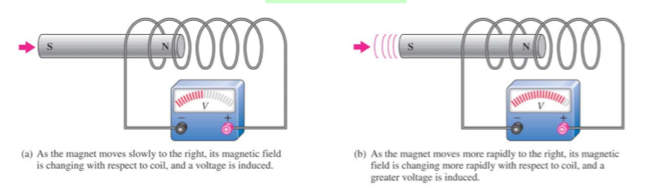

Slide 23
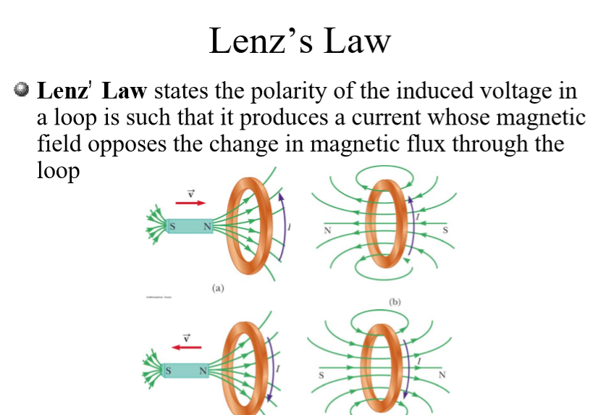

Slide 24

The negative sign used in Faraday's law of electromagnetic induction, indicates that the induced emf and the change in magnetic flux have opposite signs.

Slide 25
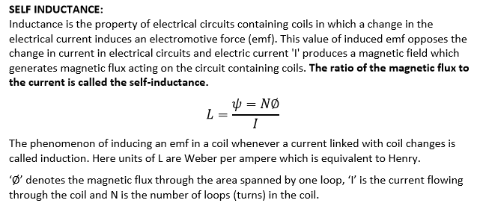

Slide 26
MUTUAL INDUCTANCE:
Mutual Inductance is the ratio between induced Electro Motive Force across a coil to the rate of change of current of another adjacent coil in such a way that two coils are in possibility of flux linkage. Mutual induction is a phenomenon when a coil gets induced in EMF across it due to rate of change current in adjacent coil in such a way that the flux of one coil current gets linkage of another coil. Mutual inductance is denoted as (M), it is called co-efficient of Mutual Induction between two coils

Slide 27
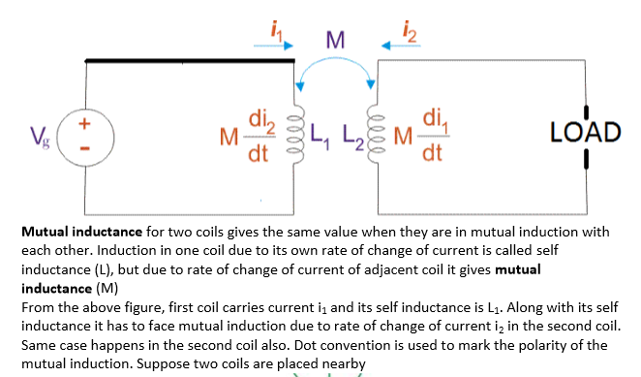

Slide 28
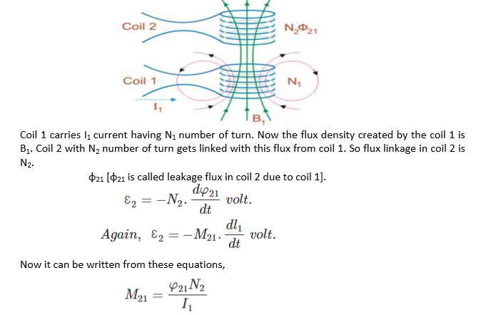

Slide 29
DOT CONVENTION:
Dot convention is used to determine the polarity of a magnetic coil in respect of other magnetic coil. Dot convention is normally used to determine the total or equivalent inductance (Leq).

Slide 30
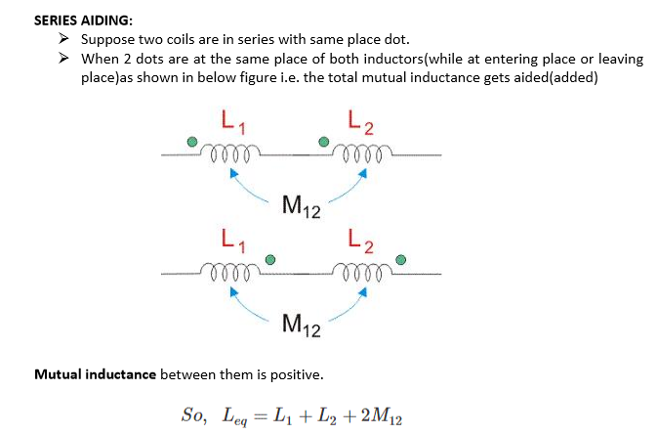

Slide 31
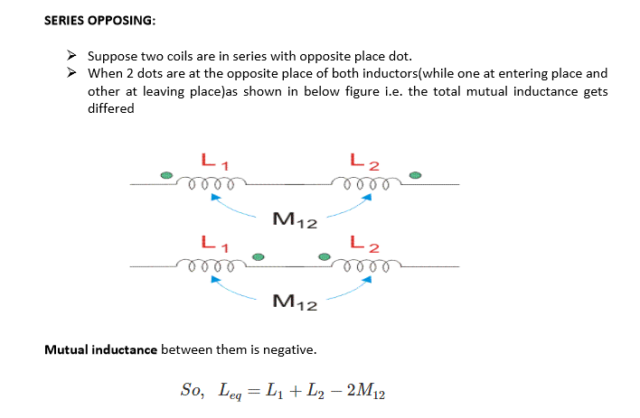

Slide 32
PARALLEL AIDING:
Suppose two coils are in parallel with same place dot. When 2 dots are at the same place of both inductors(while at entering place or leaving place)as shown in below figure i.e. the total mutual inductance gets aided(added)

Slide 33
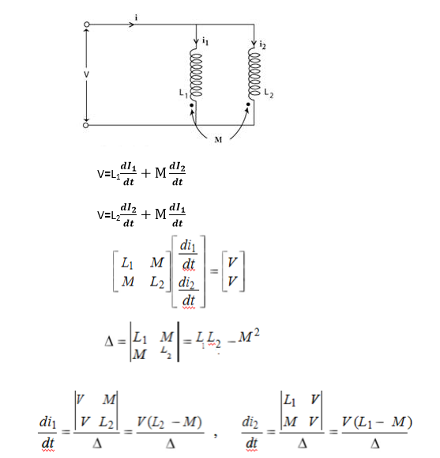

Slide 34
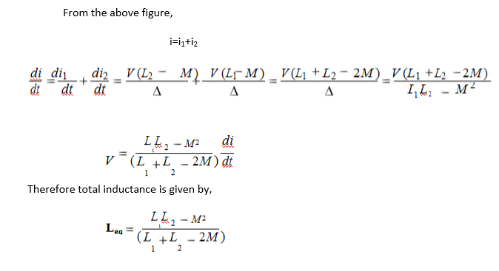

Slide 35
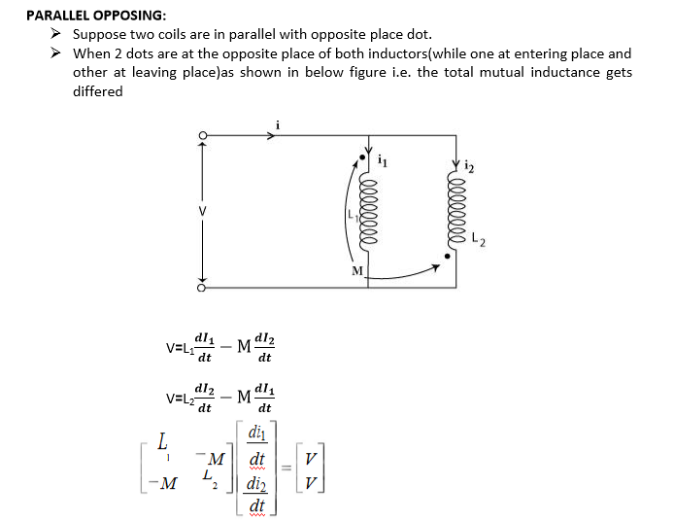

Slide 36
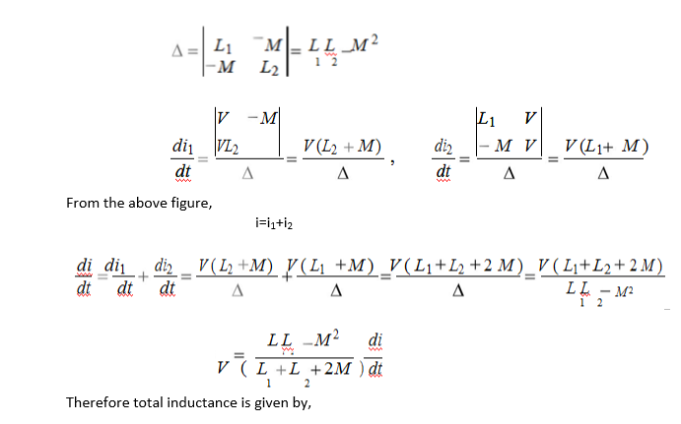

Slide 37
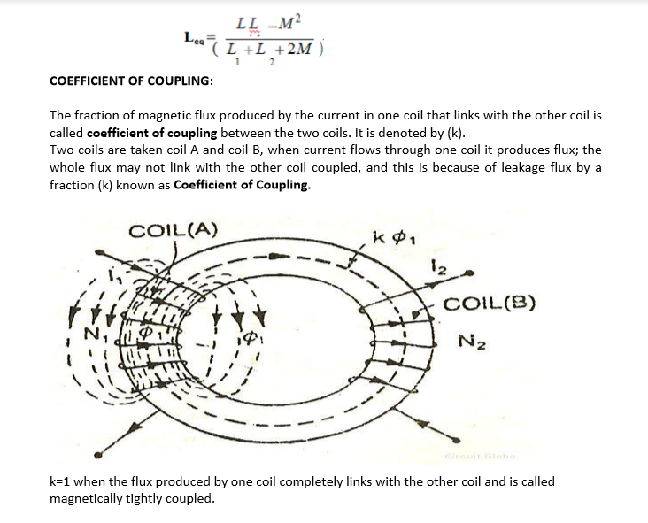

Slide 38
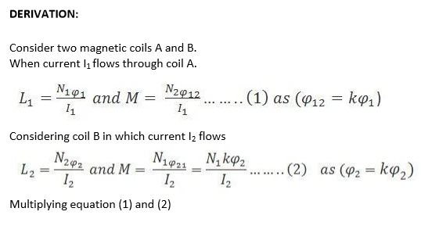

Slide 39
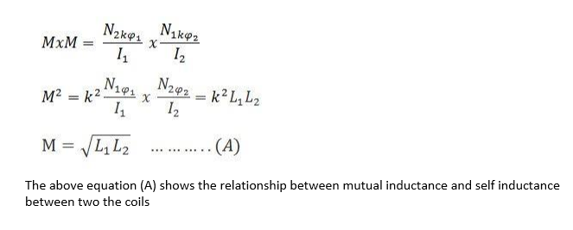

Slide 40
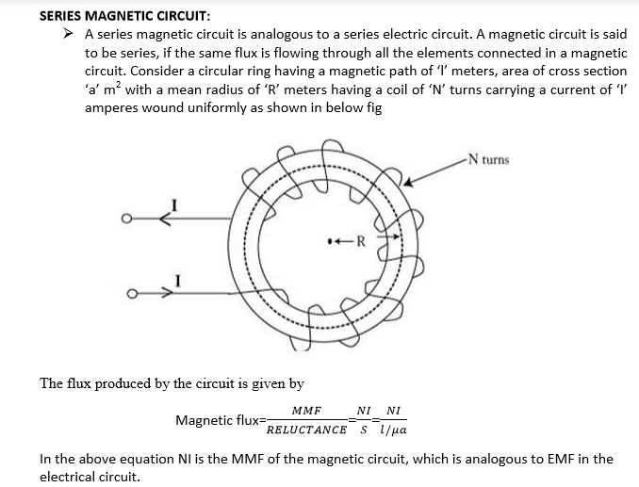

Slide 41
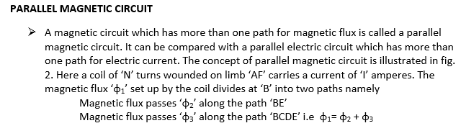

Slide 42
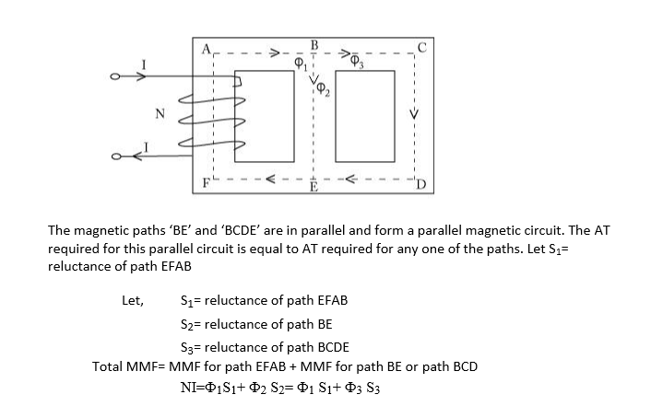

Slide 43
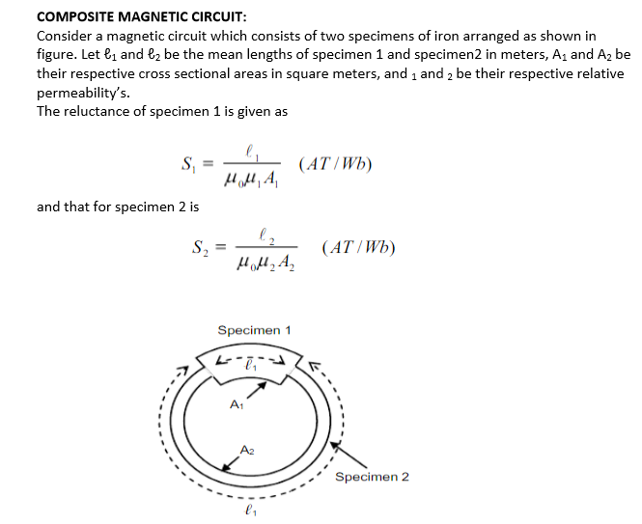

Slide 44
